Slide 1
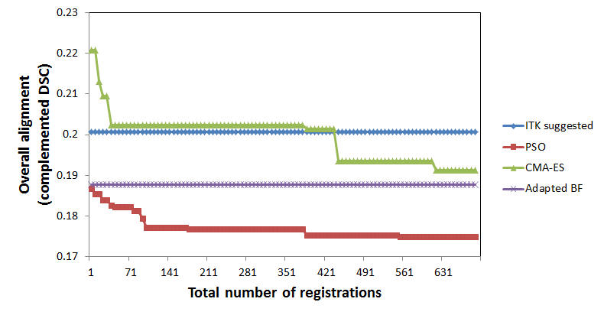
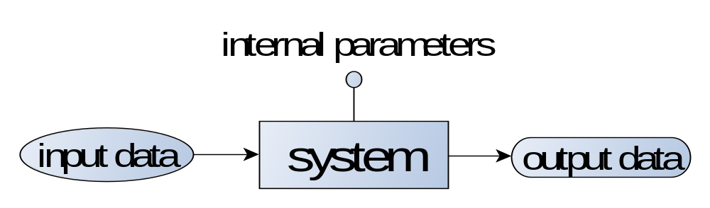
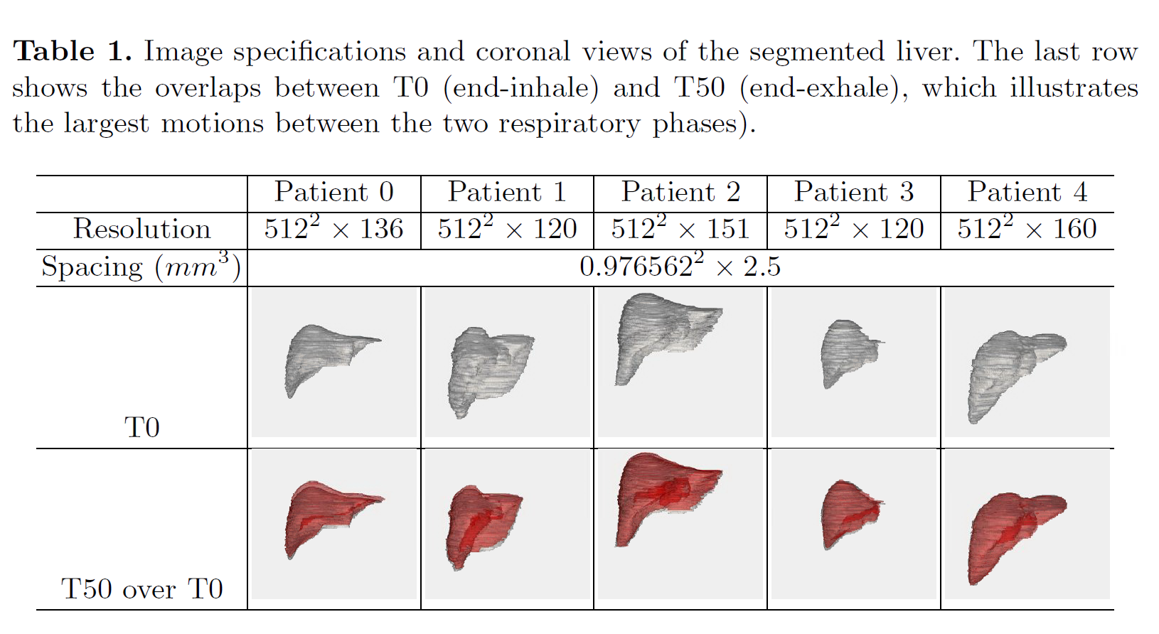
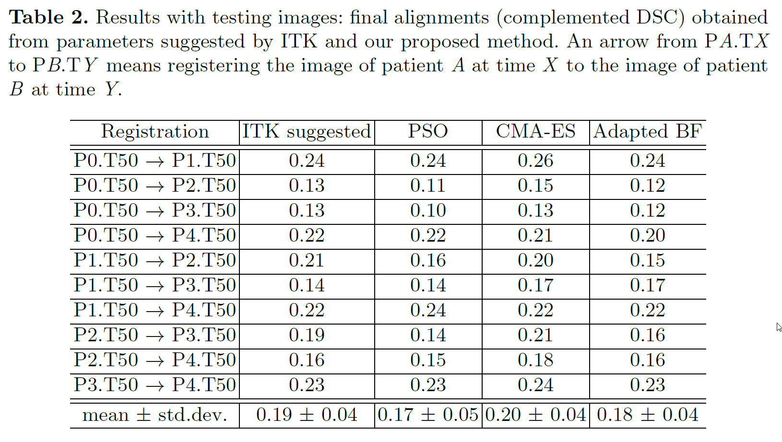
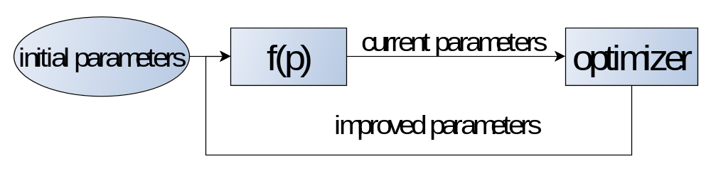
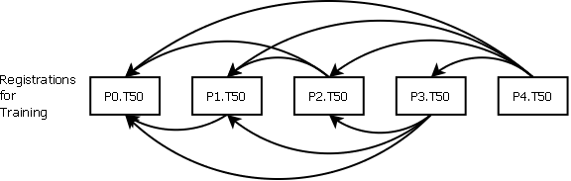
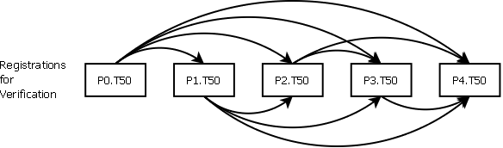
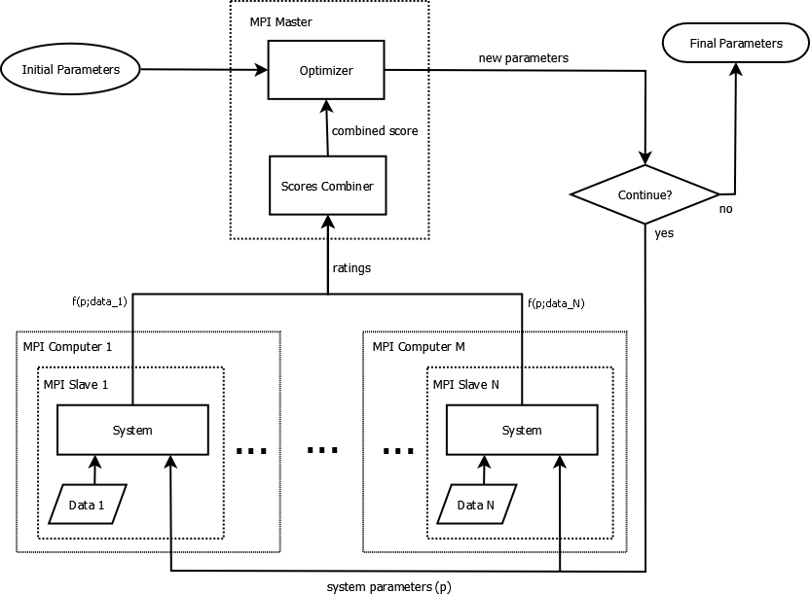
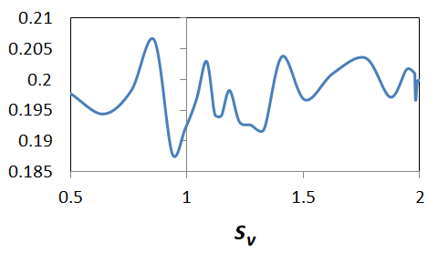
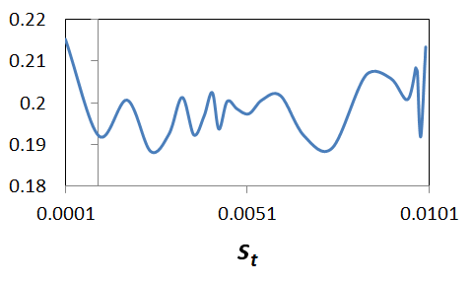
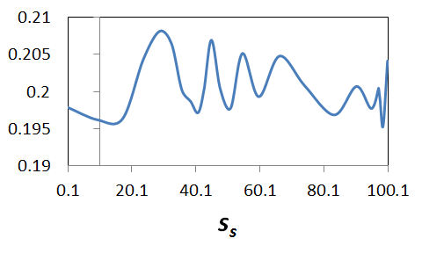
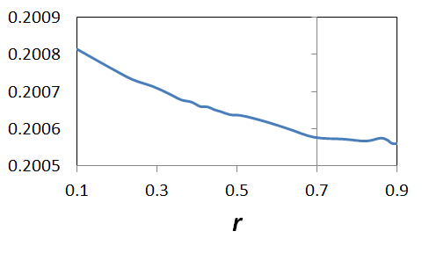
A Framework for System Parameters Tuning and Its Application in Image Registration
Ren-Hui Gong* and Ziv Yaniv*
*Sheikh Zayed Institute for Pediatric Surgical Innovation, Children's National Medical Center, Washington, DC 20010, USA
Introduction
Results
4. Training results
A system processes some input data and produces some output data. The quality of processing depends on a set of internal parameters.
A multi-level 3D registration problem was used to test the described method, and there are four internal parameters to be tuned/determined.
1st level: rigid registration using Gradient Descent (GD), three system parameters, i.e. optimization scaling factors for different transformation components, s_{v} for vesor rotation, s_{t} for translation, and s_{s} for scaling.
2nd level: B-spline deformable registration using GD, one system parameter, r, i.e. relaxation factor between iterations.
Traditionally, the values of the internal parameters were determined empirically through trial-and-error, thus the obtained parameters may not be optimal.
We propose a framework such that this task can be done systematically and intuitively.
We use a common registration problem to validate our idea.
We study the method’s behaviors under three different optimization algorithms, i.e., Particle Swarm Optimization (PSO)⁴, Covariance Matrix Adaptation Evolution Strategy (CMA-ES)⁵, and adaptive Brute-Force search (commonly used in empirical approach).
1.Testing data: 4D CT abdominal images from five patients
5. Verification results
Method
The main idea is to represent the quality of processing as a function of the internal parameters, and use an optimization algorithm to search a set of optimal values for the parameters (a meta-optimization approach¹).
Challenge 1: How to define the function f(p)?
Answer: Train the system using a set of training examples that capture the most variability of the user data, and evaluate the overall quality of the outputs.
2.Testing scheme
Conclusion
Challenge 2: The size of the training examples can be very large in order to get a good estimate of f(p). How to implement it efficiently?
Answer: Use a cluster of workstations that are linked with Message Passing Interface (MPI)² to solve the problem collaboratively.
The proposed method provides a systematic way for system parameters tuning or determination.
With same computation cost as the conventional method, the proposed method was able to provide improved system parameters.
The method is more intuitive to use.
By using the MPI technique, the method can be implemented on a cluster of workstations or personnel computers.
Challenge 3: How to evaluate the quality of the output intuitively for a given training example?
Answer: Depends on the context application. In the domain of image registration, we manually segment an anatomy of interest, and evaluate the overlap, i.e. Dice Similarity Coefficient (DSC)³, of the anatomy before and after registrations.
References
3. f(p) plots along individual parameter axes
Karpenko, A.P., Svianadze, Z.O.: Meta-optimization based on self-organizing map and genetic algorithm. Optical Memory & Neural Networks, 2011
Skjellum, A., Doss, N.E., Viswanathan, K., Chowdappa, A., Bangalore, P.V.: Extending the massage passing interface (MPI). Scalable Parallel Libraries, 1994
Dice, L.R.: Measures of the amount of ecologic association between species. Ecology, 1945
Kennedy, J., Eberhart, R.: Particle swarm optimization. IEEE Conference on Neural Networks, 1995
Hansen, N.: The CMA evolution strategy: A comparing review. Advances on estimation of distrubution algorithms, 2006
Acknowledgement
This work was done under NIH/NLM contract HHSN276201000578P.

